Slide 1

Minor Presentation
Session 2021-22
मौलाना आजाद राष्ट्रीय प्रौद्योगिकी संस्थान, भोपाल
MAULANA AZAD NATIONAL INSTITUTE OF
TECHNOLOGY
BHOPAL (M.P.) 462003
DEPARTMENT OF CIVIL ENGINEERING

Slide 2
DEVELOPMENT OF C++ PROGRAMME FOR DETERMINATION OF BEARING CAPACITY OF SOIL
by,
YASHPAL SOLANKI (191111054)
PRIYOM GUPTA(191111060)
AMAN KUMAR (191111063)
Supervisor:
DR. RAKESH KUMAR
(Associate Professor – Civil Engineering Department)

Slide 3
INTRODUCTION
Structural foundations are the substructure element which transmits the structural load to the earth in such a way that the supporting soil is not overstressed and not undergo deformations that would cause excessive settlement of the structure.
A foundation is that part of a structure which transmits the weight of the structure to the ground. A foundation is required for distributing the loads of the superstructure on a large area. For proportioning of such foundations safe bearing capacity, are the main criteria.
Broadly Foundation is classified into two types:
Shallow Foundation
Deep Foundation

Slide 4
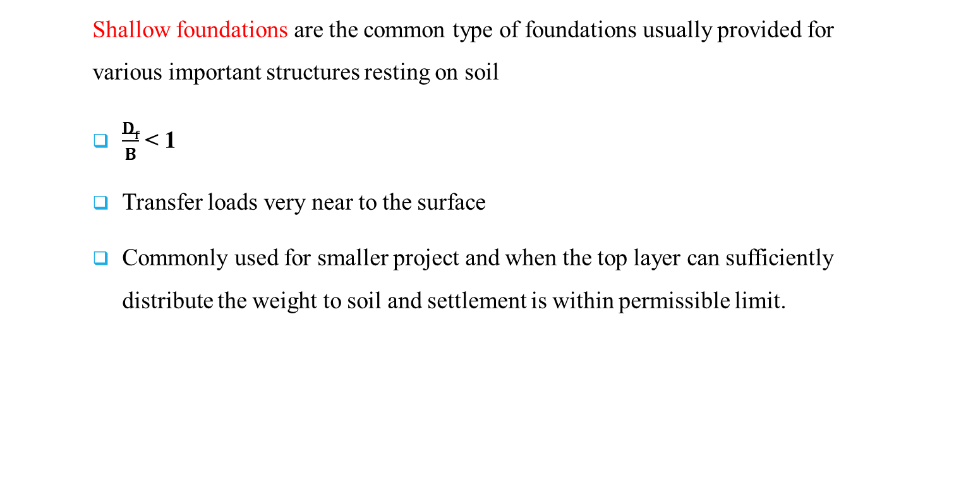
SHALLOW FOUNDATION
Shallow foundations are the common type of foundations usually provided for various important structures resting on soil
$\frac{Df}{B}$ < 1
Transfer loads very near to the surface
Commonly used for smaller project and when the top layer can sufficiently distribute the weight to soil and settlement is within permissible limit.

Slide 5
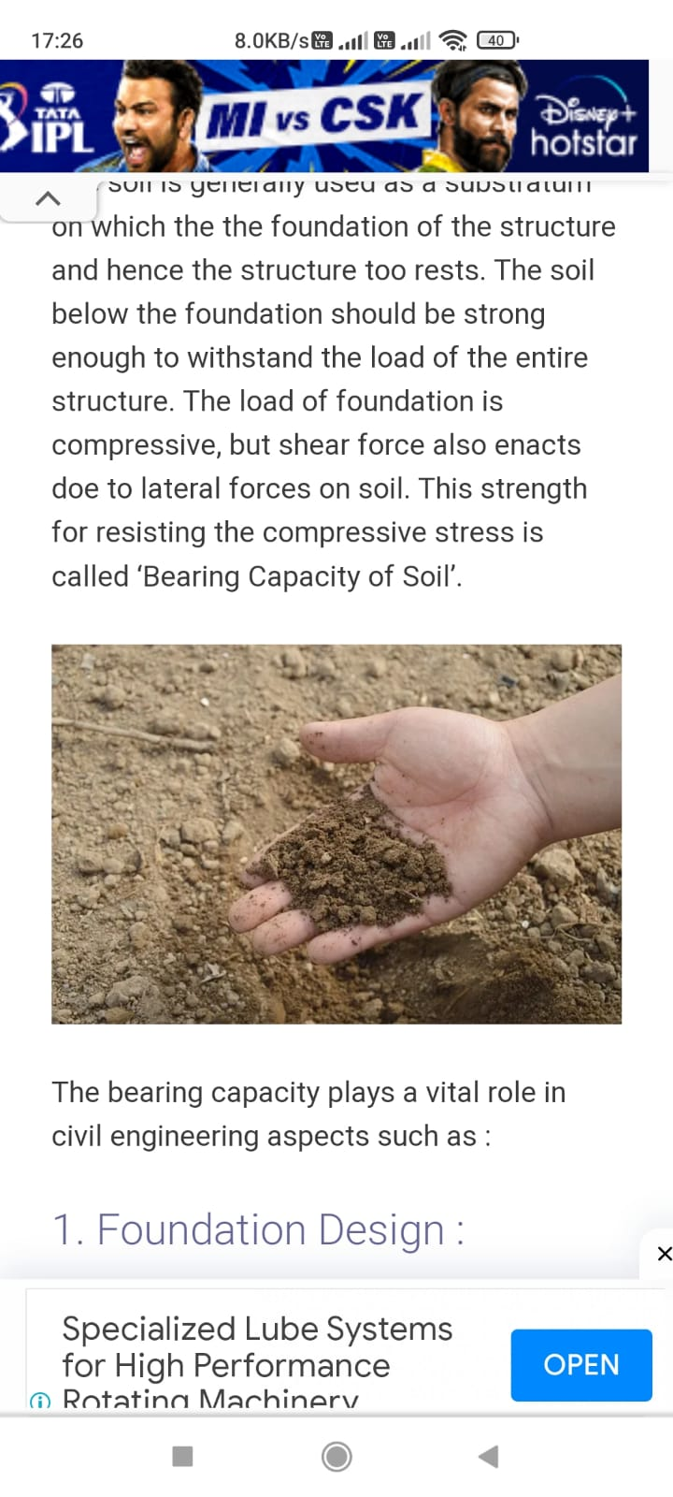
OBJECTIVES OF STUDY
The main objective of this study is to develop a computer program in C++ LANGUAGE for determination of bearing capacity of shallow foundation as per IS Code 6403- 1981.

Slide 6
TYPES OF SHALLOW FOUNDATION
Isolated footing
Combined footing
Strap footing
Grillage footing
Mat or raft footing

Slide 7
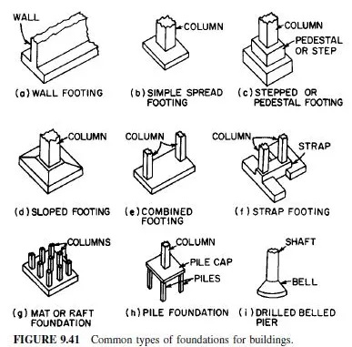
TYPES OF SHALLOW FOUNDATION

Slide 8
SELECTION OF TYPE OF FOUNDATION
Type of footing condition
Spread footing footing which supports load bearing wall
and L >> B .
Combined footing footing which support two or more column and
column carry unequal loads
when columns are near to each other.
Isolated square footing To support individual columns.
Continuous footing foundation suitable for earthquake area

Slide 9
GENERAL TERMS AND DEFINITIONS
Ultimate Bearing Capacity
If the load at the base of footing is gradually increased, a stage will be reached when the load will cause a shear failure in the supporting soil. The maximum gross intensity of loading that the soil can support before it fails in shear is called the Ultimate Bearing Capacity.
Net Ultimate Bearing Capacity
Net Ultimate bearing capacity is the maximum net intensity of loading at the base of the foundation that the soil can support before failing in shear.
q_{nu} = q_{u} -γ D_{f}

Slide 10
Continue…
Net Safe Bearing Capacity
The Net safe bearing capacity is the maximum net intensity of loading that the soil can safely support without the risk of shear failure it is given by,
q_{nu} / F
Gross Safe Bearing Capacity
Gross safe bearing capacity is the maximum gross intensity of loading that the soil can carry safely without failing in shear it is given by,
q_{g} = q_{n} + γ D_{f}

Slide 11
Factors Affecting Bearing Capacity
The type of soil and its properties.
The form and size of the footing in plan.
The depth of footing below the ground surface.
The position of the water table below ground surface.
The position of load application on footing.

Slide 12
Type of Bearing Capacity Failure
Three types of failure of soil support beneath the foundation have been recognized, depending upon the deformation associated with the load and the extent of development of failure surface.
General shear failure
Local shear failure
Punching shear failure

Slide 13
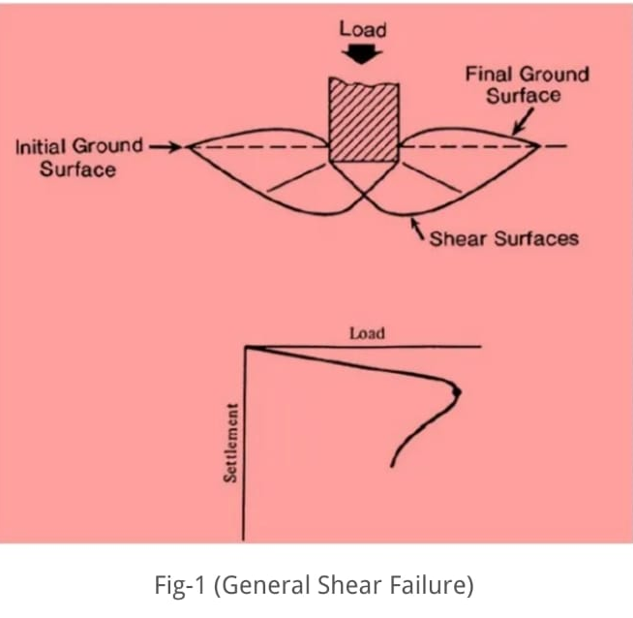
General Shear Failure:
It has a well-defined failure pattern.
Failure is sudden and catastrophic.
Failure is accompanied by tilting of foundation

Slide 14
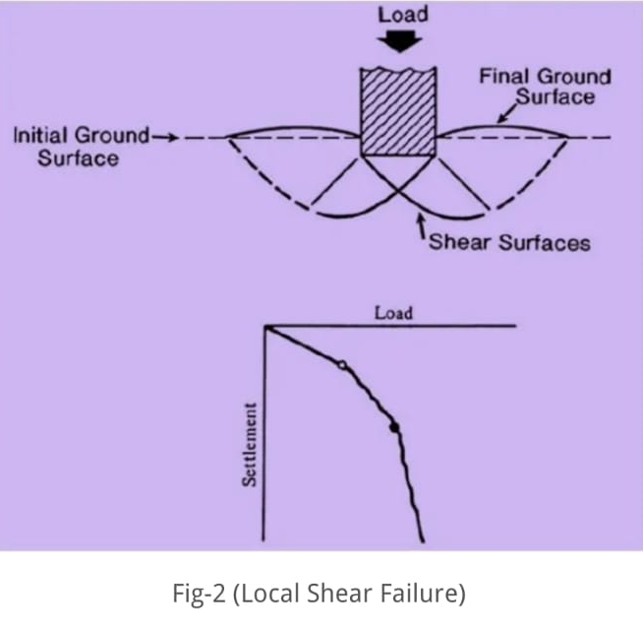
Local Shear Failure: (a) Failure pattern is clearly defined only immediately below the foundation. (b) There is no catastrophic collapse or tilting of foundation. (c) There is visible soil bulging on the sides of footing (d) It is a transitional mode of failure retaining the characteristics of both general shear failure and punching shear failure.

Slide 15
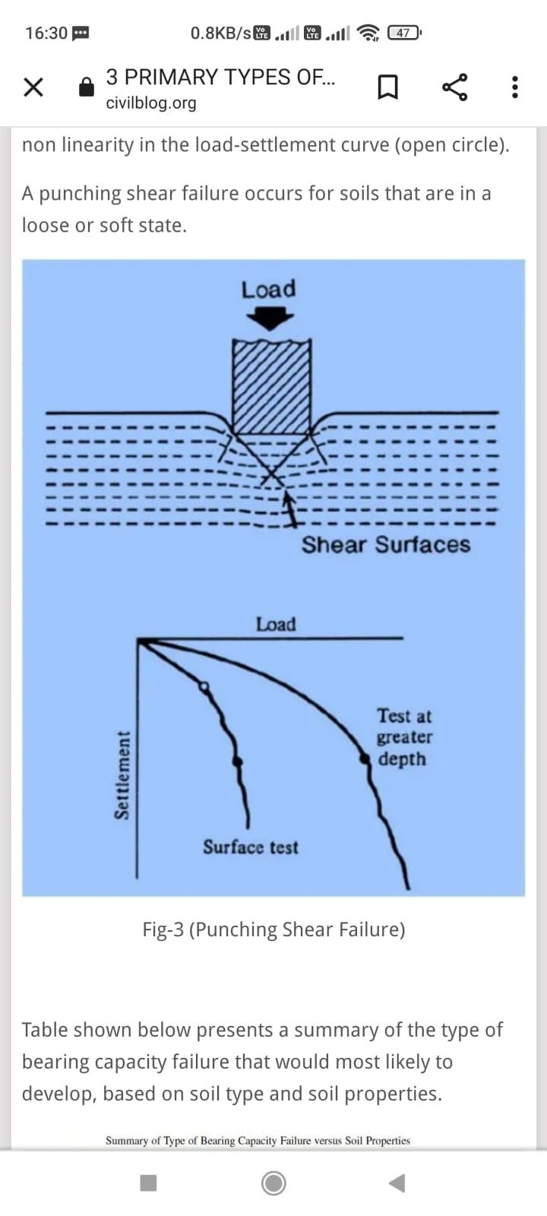
PUNCHING SHEAR FAILURE:
failure pattern is not easy to observe.
Soil outside the loaded area is not affected.
Horizontal and vertical equilibrium footing are maintained .

Slide 16
Basic Approaches for the Calculation of Bearing Capacity of Soil
The following approaches are widely discussed in literature:-
Terzaghi's Bearing Capacity
Meyerhof’s Bearing Capacity Theory
IS code method

Slide 17
Calculation of bearing capacity by IS code for soils with cohesion and Angle of shearing Resistance:-
The following formulae shall be used for calculating ultimate net bearing capacity in the case of strip footing:
In case of general shear failure = c NcScDcIc + q (Nq -l)SqDqIq + 1/2 Bf N γSyDyIy
In case of local shear failure = 2/3 N’ cScDcIc + q (N’q - l)SqDqIq + 1/2 Bf N’γSyDyIy

Slide 18
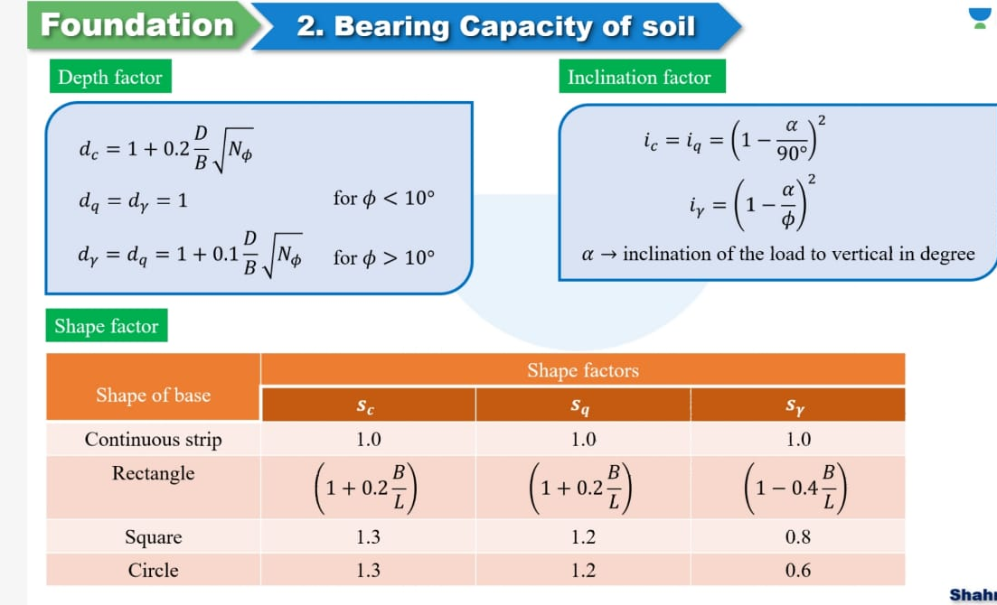

Slide 19
DEVELOPMENT OF SOFTWARE:
This package has been developed in C++ programming specially using its features and can be run on any personal computer. It is a user-friendly package, which provides necessary guidance on input data at every step.

Slide 20
C++ PROGRAMME
#include <iostream>
#include <cmath>
using namespace std;
int main() {
double c,phi;
cout<<"Input value of c: ";
cin>>c;
cout<<"Input value of phi: ";
cin>>phi;
double deg=M_PI/180;
double phi_d=phi/2;
phi=phi*deg;
phi_d=deg*phi_d;
double N_phi=tan(45*deg+ (phi_d));
N_phi=N_phi*N_phi;
double N_q=N_phi*exp(M_PI*tan(phi));
cout<<"N_q "<<N_q<<endl;
double N_gamma=2*(tan(phi))*(N_q +1);

Slide 21
double N_c = (1/tan(phi))*(N_q -1);
cout<<"N_c"<<N_c<<endl;
cout<<"N_gamma"<<N_gamma<<endl;
string s;
cout<<"Input type of footing: ";
cin>>s;
double s_c,s_q,s_gamma;
double b,gamma,w,d,alpha;
cout<<"Input value of b:";
cin>>b;
cout<<"Input value of gamma:";
cin>>gamma;
cout<<"Input value of w:";
cin>>w;
cout<<"Input value of d:";
cin>>d;

Slide 22
cout<<"Input value of alpha:";
cin>>alpha;
// cin>>b>>gamma>>w>>d>>alpha;
double q=gamma*d;
double qu;
if(s=="strip"){
s_c=1.00;
s_q=1.00;
s_gamma=1.00;}
else if(s=="rectangle"){
double b,l;
cout<<"Input value of b:";
cin>>b;
cout<<"Input value of l:";
cin>>l;
s_c=1+0.2*(double (b)/double (l));
s_q=1+0.2*(double (b)/double (l));
s_gamma=1-0.4*(double (b)/double (l));
}

Slide 23
else if(s=="square"){
s_c=1.30;
s_q=1.20;
s_gamma=0.80;
}
else if(s=="circle"){
s_c=1.30;
s_q=1.20;
s_gamma=0.60;
}
// cout<<s_c<<" "<<s_q<<" "<<s_gamma<<endl;
double dc,ic,dq,iq,d_gamma,i_gamma;
dc=(1+0.2*(d/b)*sqrt(N_phi));
dq=(1+0.1*(d/b)*sqrt(N_phi));
d_gamma=dq;
ic=pow((1-(alpha/90)),2);
iq=ic;
i_gamma=pow((1-(alpha/(phi/deg))),2);

Slide 24
cout<<dc<<" "<<dq<<" "<<d_gamma<<" "<<ic<<" "<<iq<<" "<<i_gamma<<endl;
if(phi<28*deg){
if(phi<10*deg){dq=1;d_gamma=1;}
qu= ((c*N_c*s_c*dc*ic))+(q*(N_q-1)*s_q*dq*iq)+(b*gamma*N_gamma*s_gamma*d_gamma*i_gamma*w/(2.0));
}
else if(phi>=28*deg and phi<36*deg){
double qu_l = ((c*N_c*s_c*dc*ic))+(q*(N_q-1)*s_q*dq*iq)+(b*gamma*N_gamma*s_gamma*d_gamma*i_gamma*w/(2.0));
double qu_u =(c*N_c*s_c*dc*ic)+(q*(N_q-1)*s_q*dq*iq)+(b*gamma*N_gamma*s_gamma*d_gamma*i_gamma*w/(2.0));
qu= qu_l*((phi/deg -28)/(36-28)) + qu_u*((36-phi/deg)/(36-28));
}

Slide 25
else
{
qu=(c*N_c*s_c*dc*ic)+(q*(N_q-1)*s_q*dq*iq)+(b*gamma*N_gamma*s_gamma*d_gamma*i_gamma*w/(2.0));
}
double f;
cout<<"input value of f: ";
cin>>f;
double qs;
qs = (qu/f) + (gamma*d) ;
cout<<"net ultimate bearing capacity of soil: "<<qu<<endl;
cout<<"safe bearing capacity of soil: "<<qs<<endl;
return 0;

Slide 26
Compilation and Execution:
Compilation:
This is an important step in constructing a program. In compilation, compiler links the library files with the source code and verifies each and every line of code. If any mistake or error is found, it will inform you to make corrections. If there are no errors, it translates the source code into machine readable object file with an extension .obj
Execution:
This is the final step of construction of a C++ Program. In this stage, the object file becomes an executable file with extension .exe. Once the program becomes an executable file, the program has an independent existence. This means, you can run your application without the help of any compiler or IDE.

Slide 27
ADVANTAGES OF C++ LANGUAGE:
C++ is a highly portable language
C++ gives the user complete control over memory management
It is useful for the low-level programming language and very efficient for general purpose.
C++ is an object-oriented programming language and includes which allow code reusability and makes programs very maintainable.

Slide 28
CONCLUSION
The analysis of test data for calculation of bearing capacity of soil of shallow foundation under varying condition requires references to various IS codes, graphs and tables. The work becomes tedious and consumes lot of time of Civil Engineers and Architects.
Hence there was a need to have compiled information for estimation of safe bearing capacity of shallow foundation to provide an effective as well as simple solution for reducing time by developing a computer program for the purpose. In present work, the computer program is developed in C++ PROGRAMMING.
The software can be run on any system and does not require any environment / platform. From the value of c and φ, calculation of bearing capacity for strip, square, circular footing can be estimated.

Slide 29
Thank YOU

